Slide 1
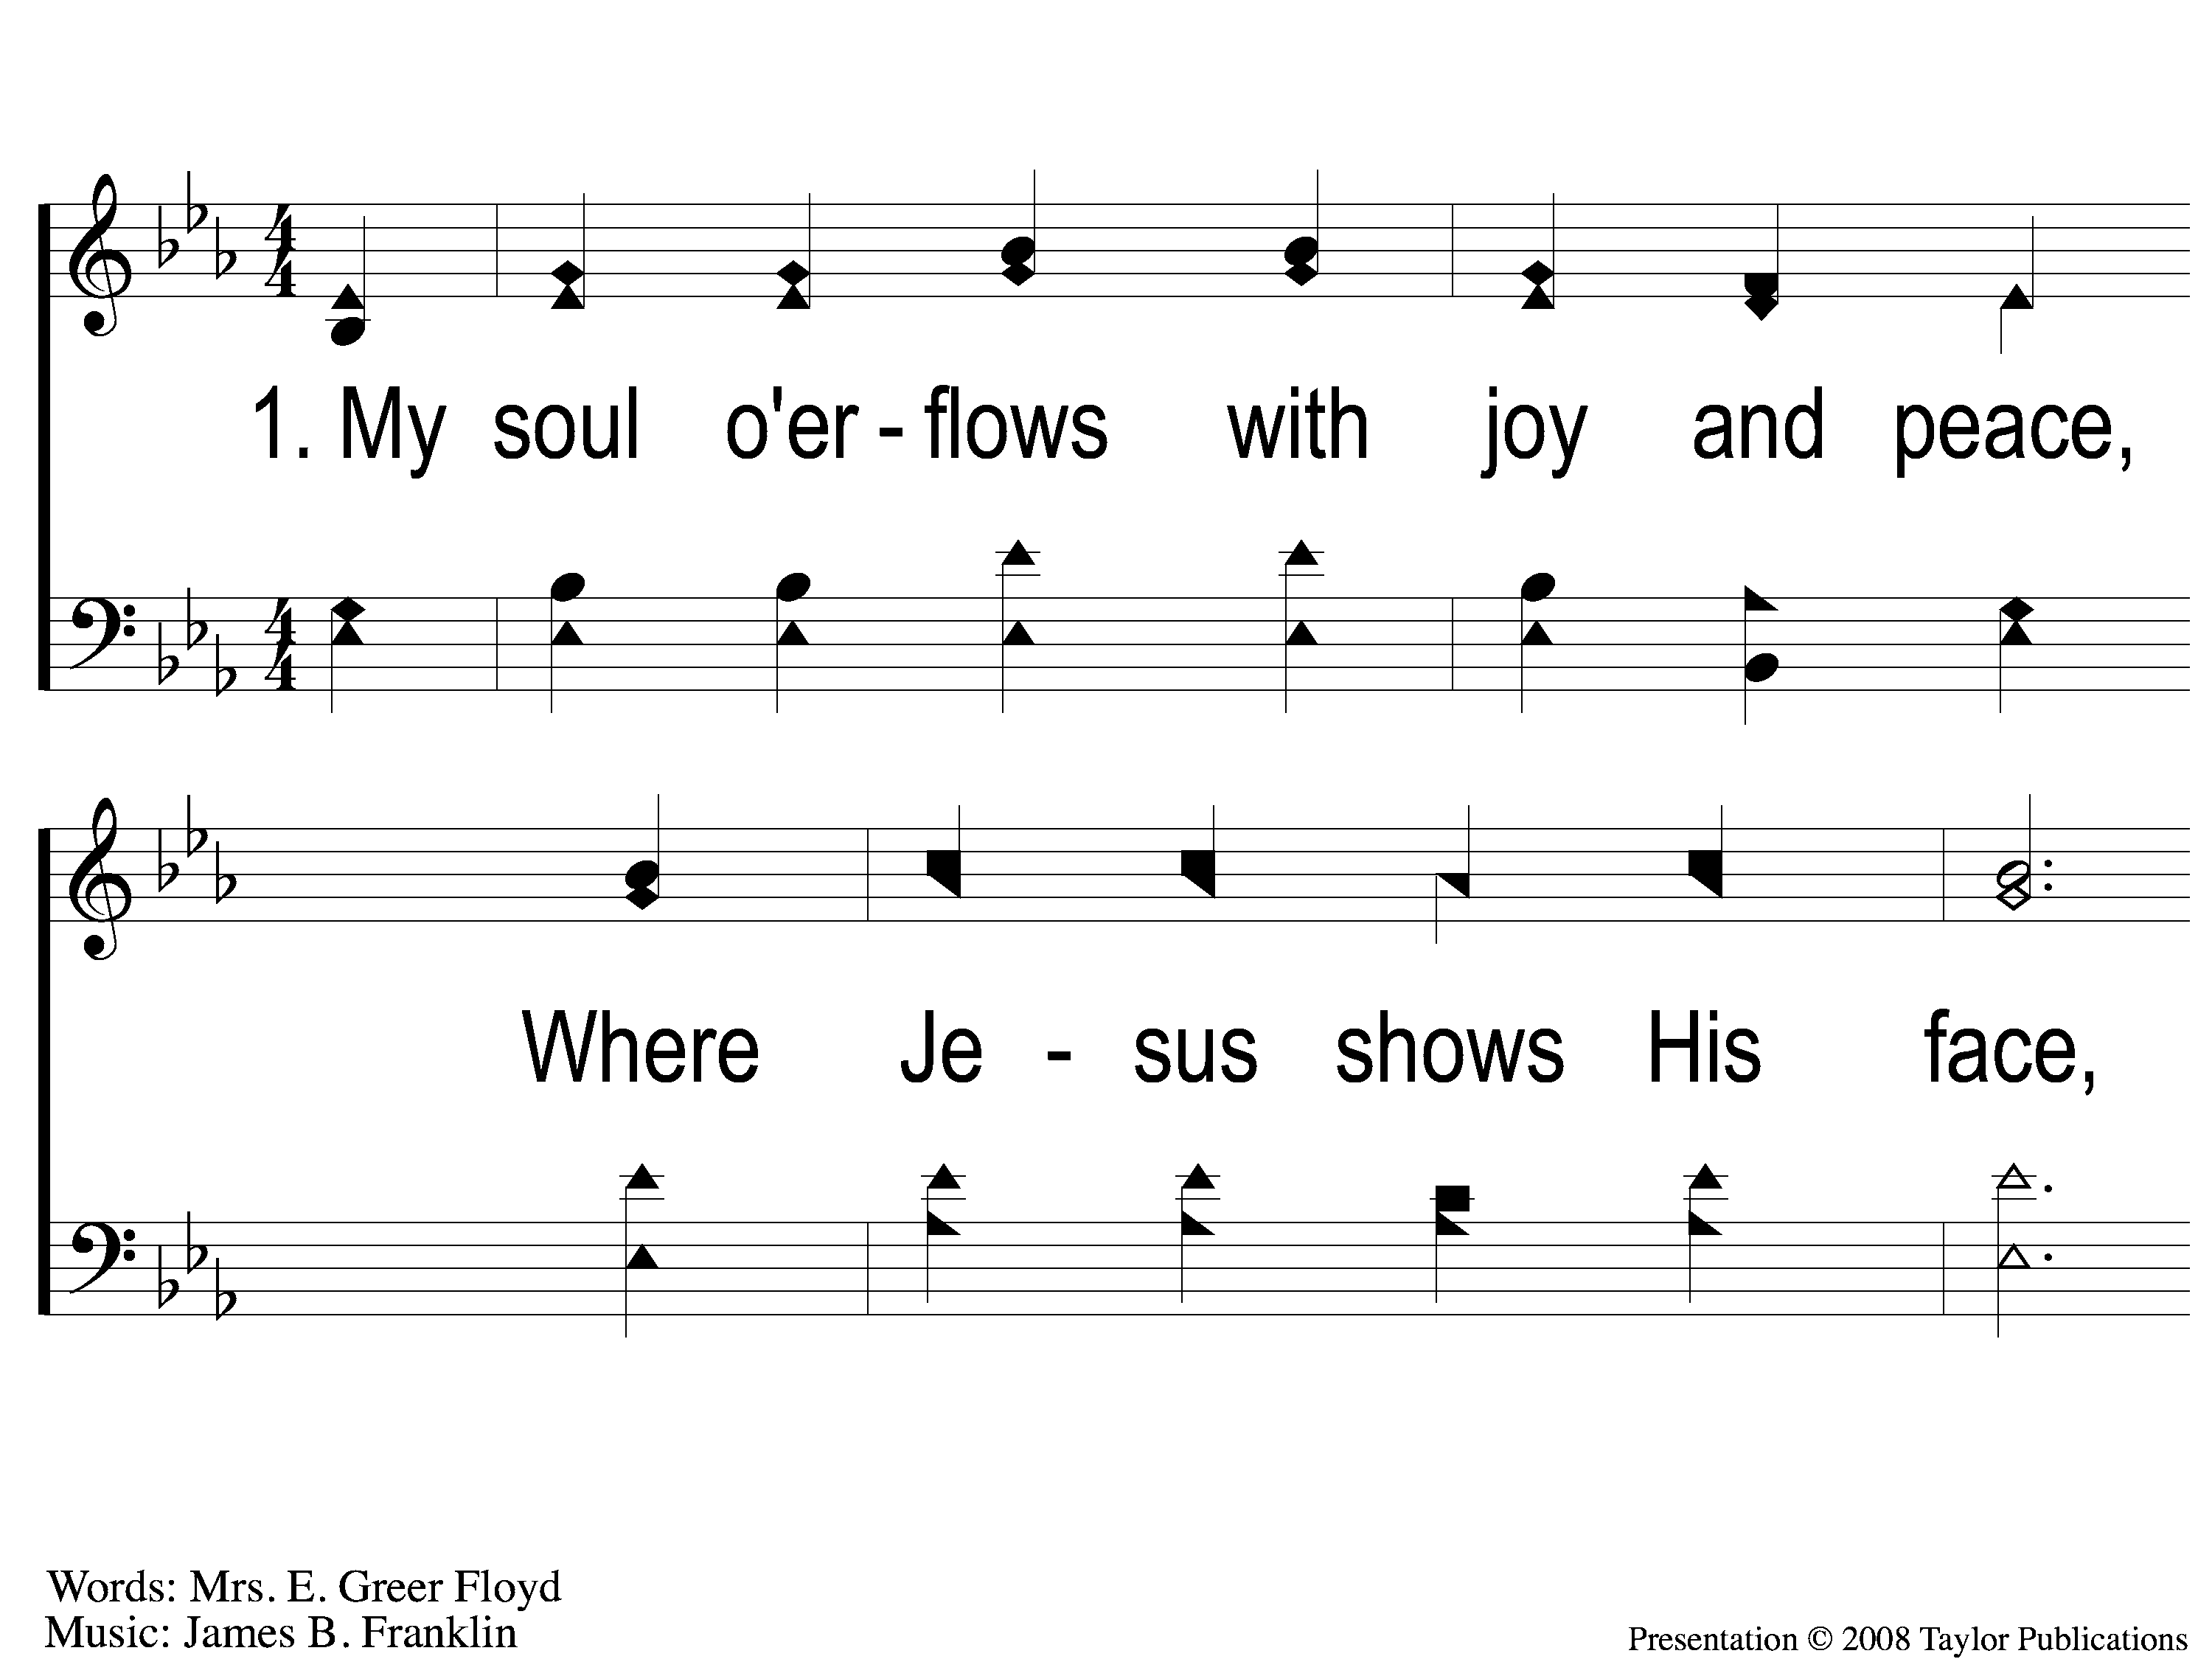
1-1 Follow On
Follow On
110

Slide 2
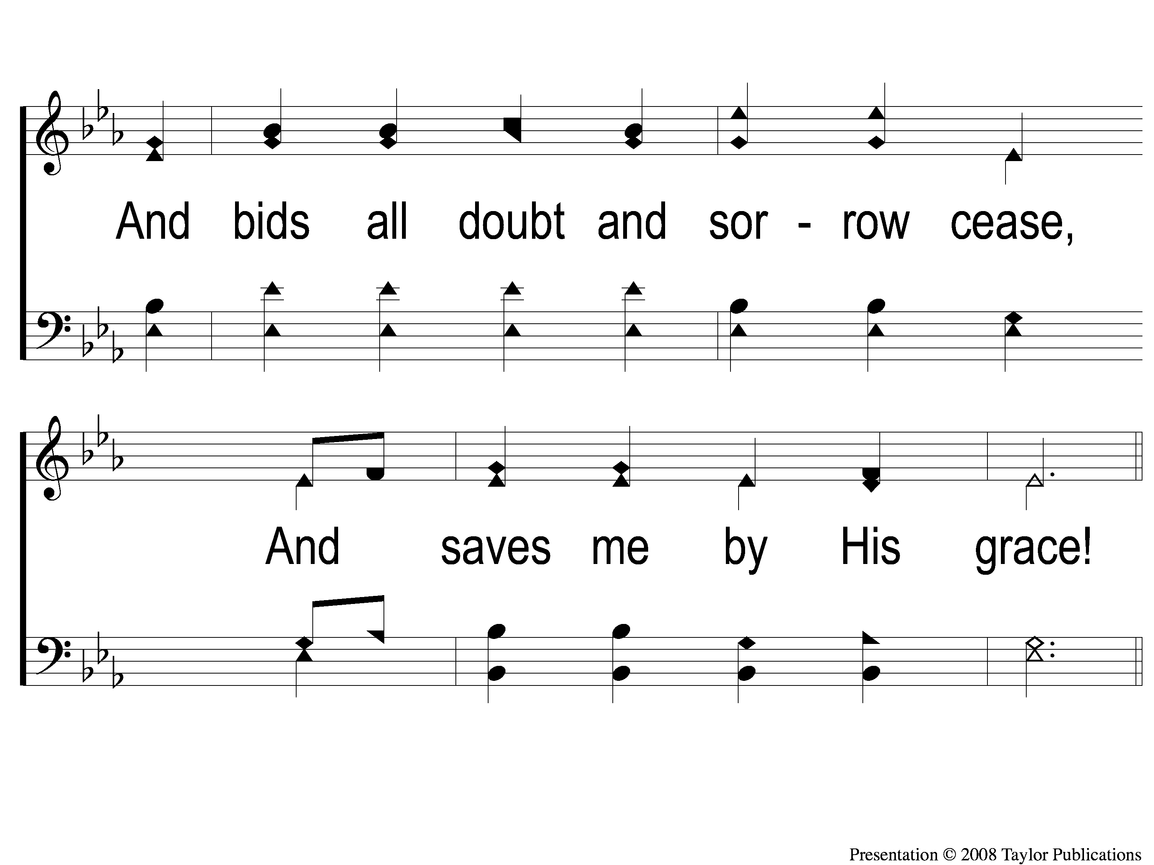
1-2 Follow On
Follow On
110

Slide 3
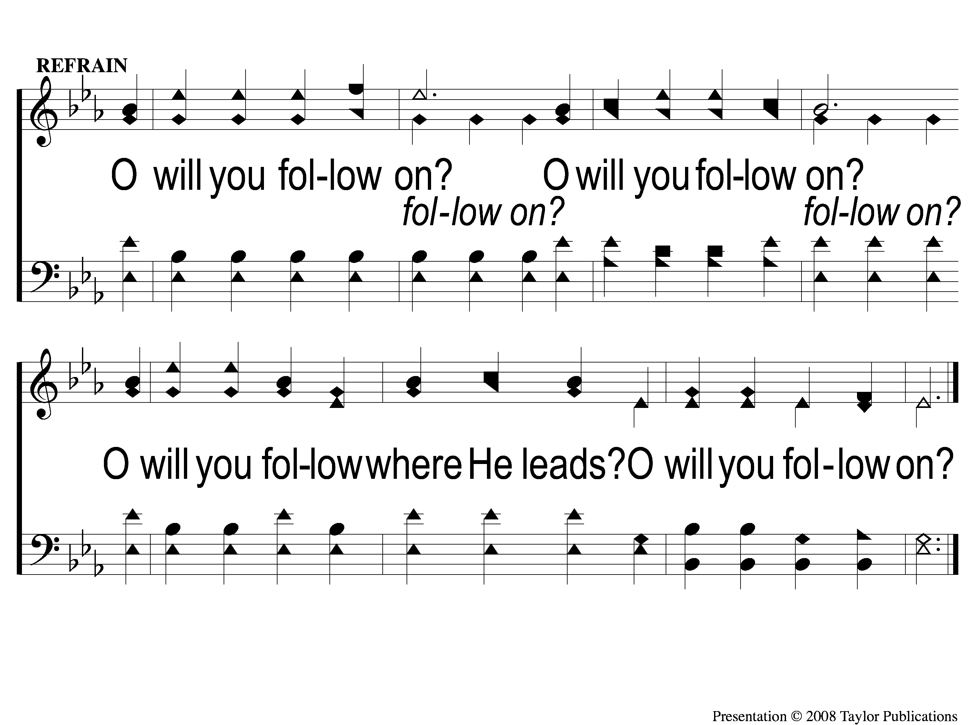
C Follow On
Follow On
110

Slide 4
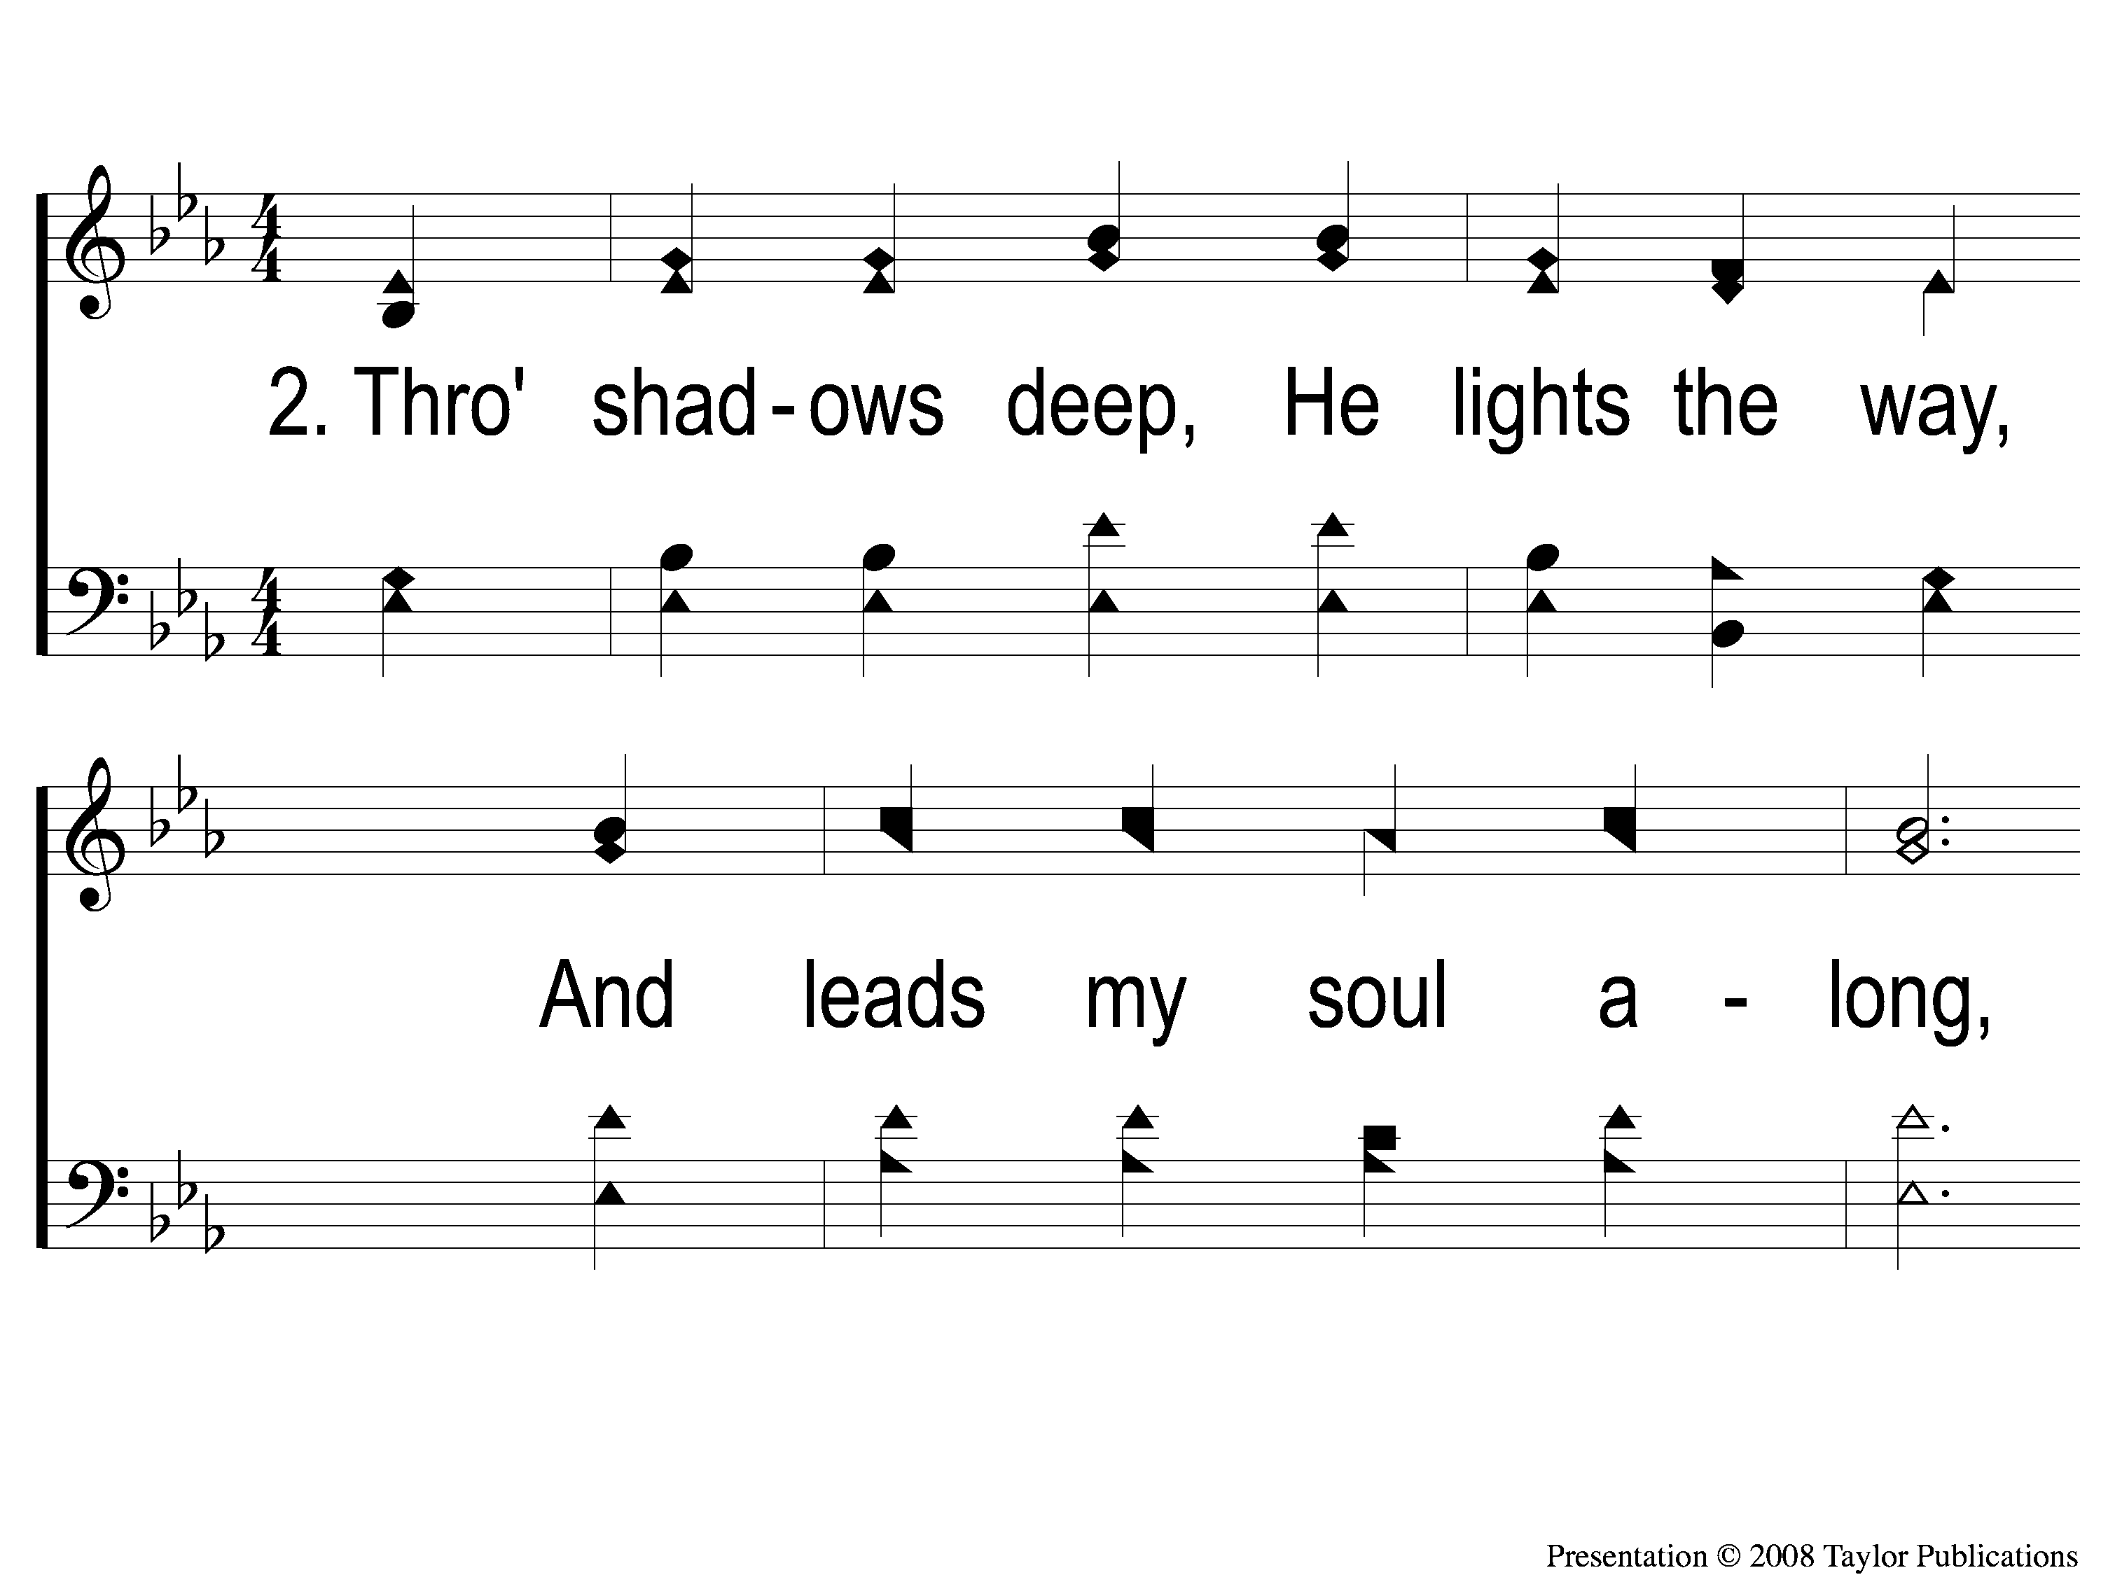
2-1 Follow On
Follow On
110

Slide 5
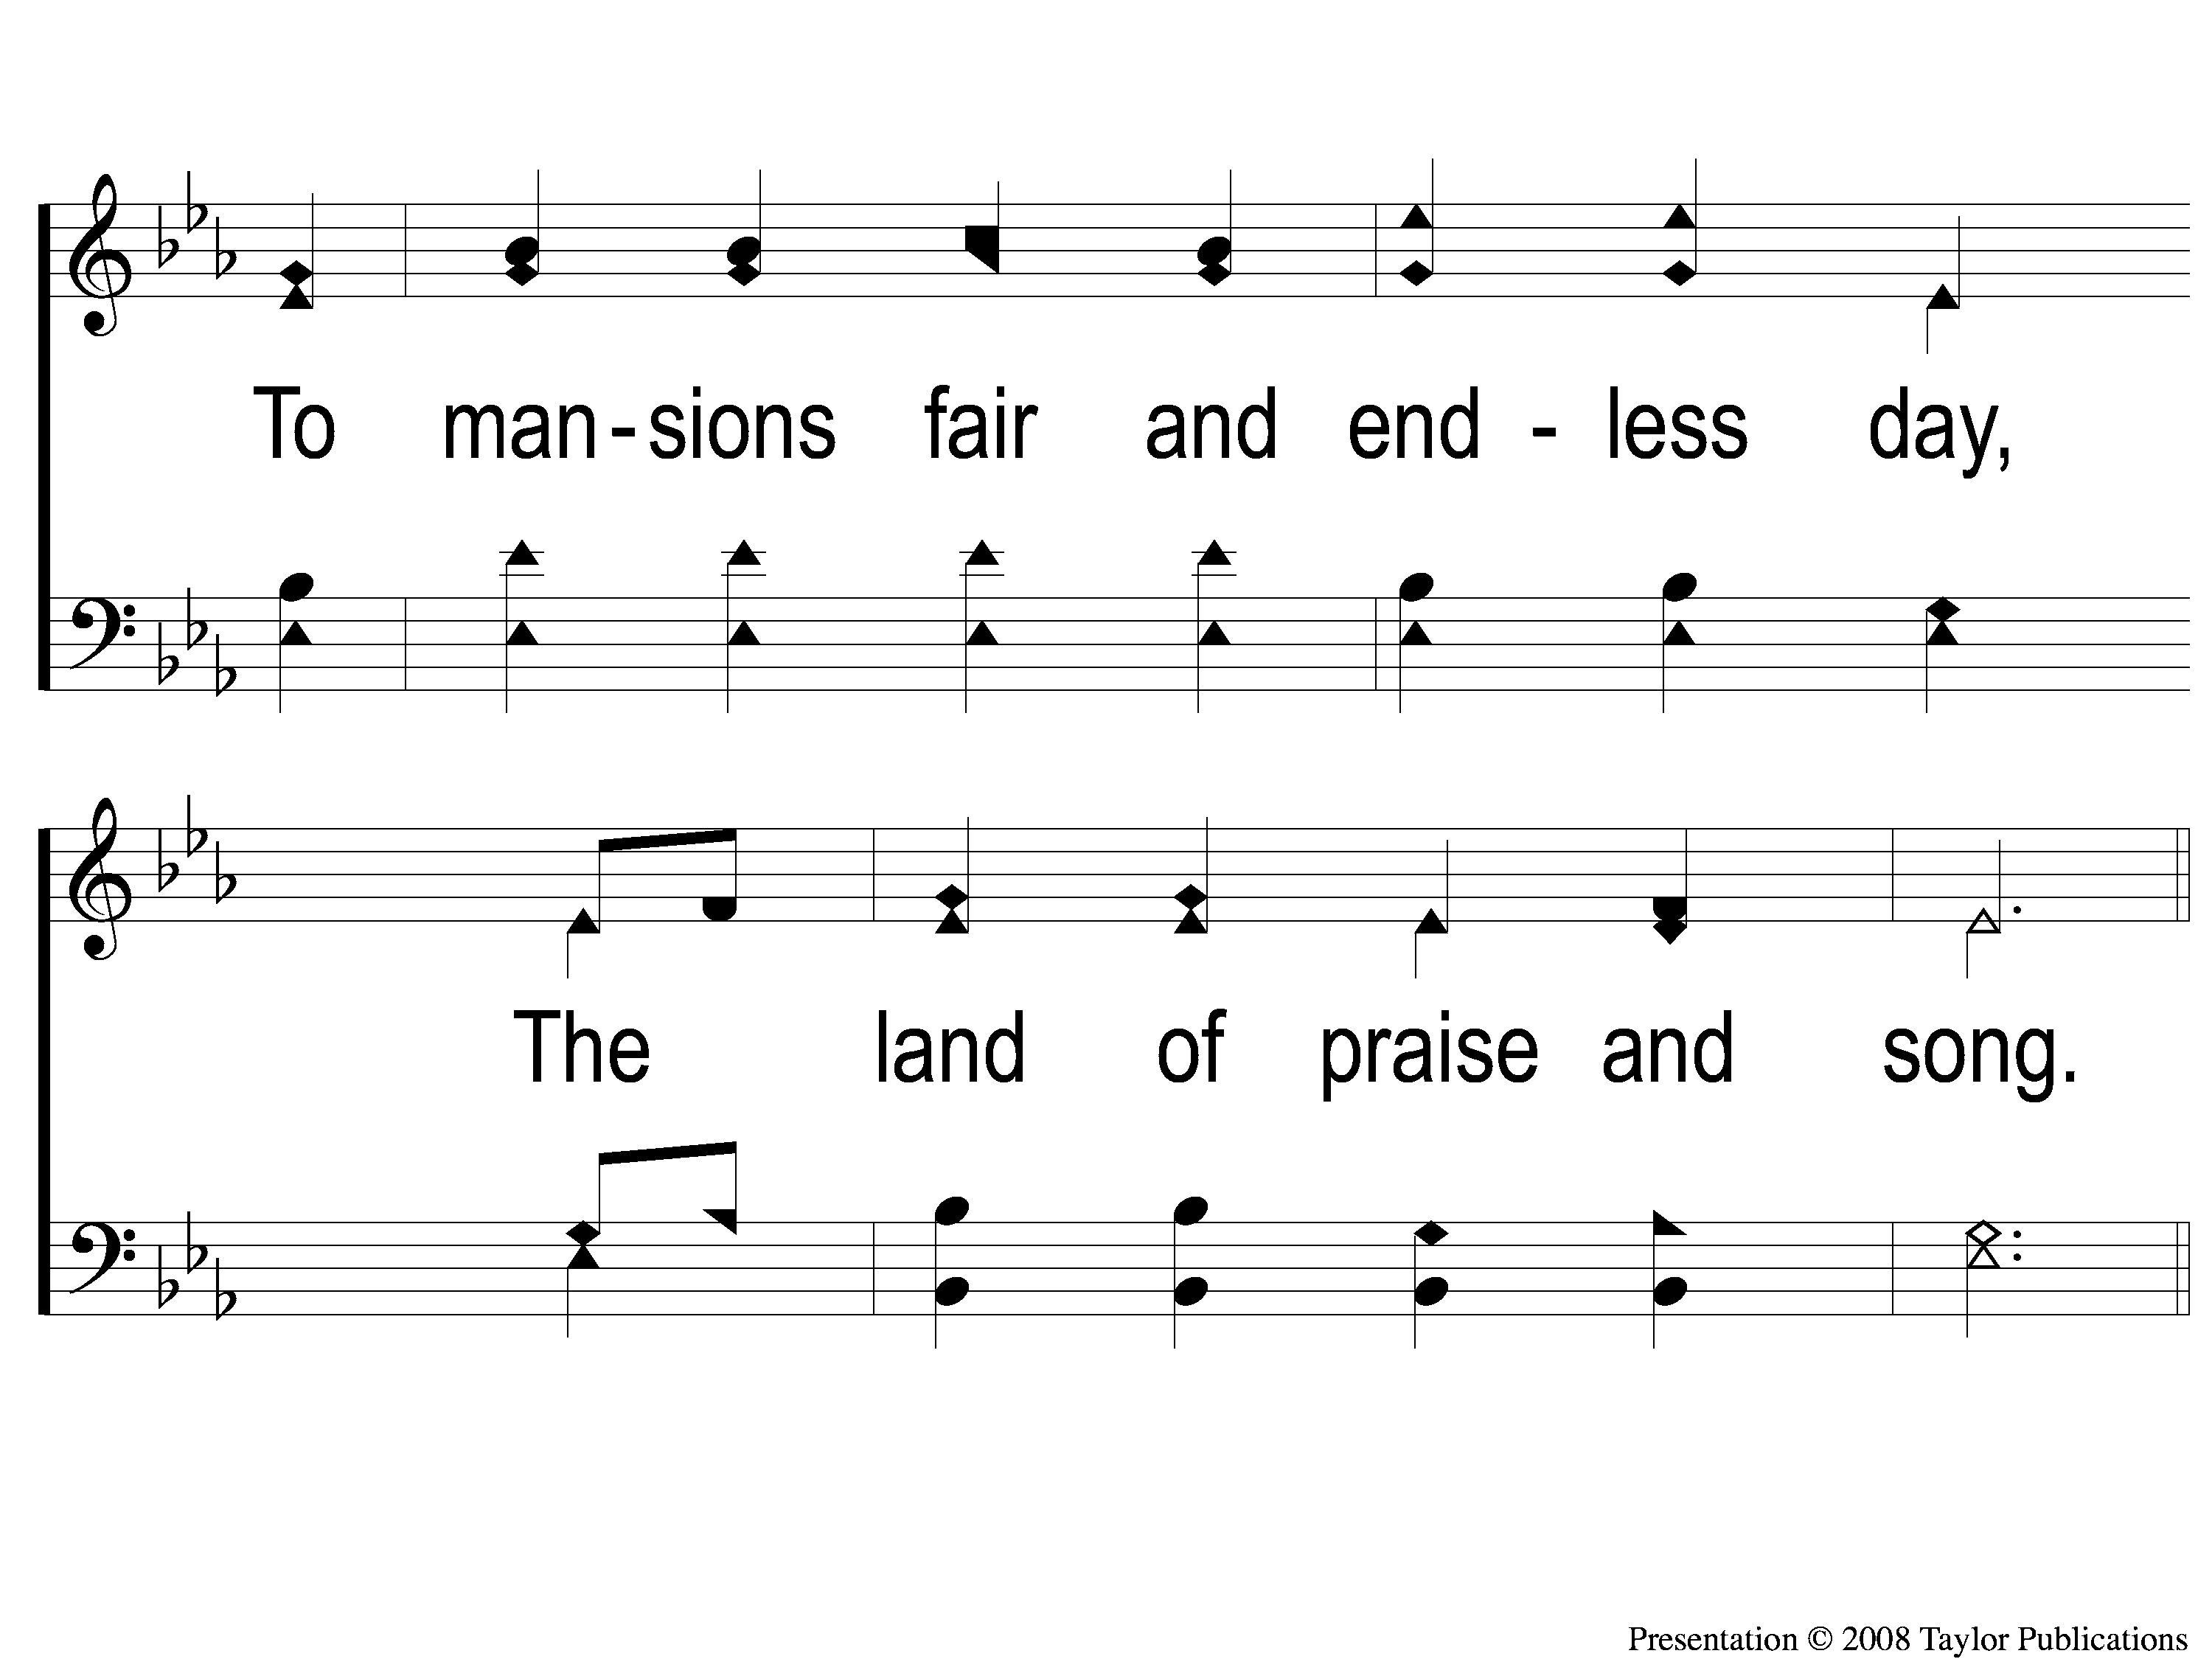
2-2 Follow On
Follow On
110

Slide 6
C Follow On
Follow On
110

Slide 7
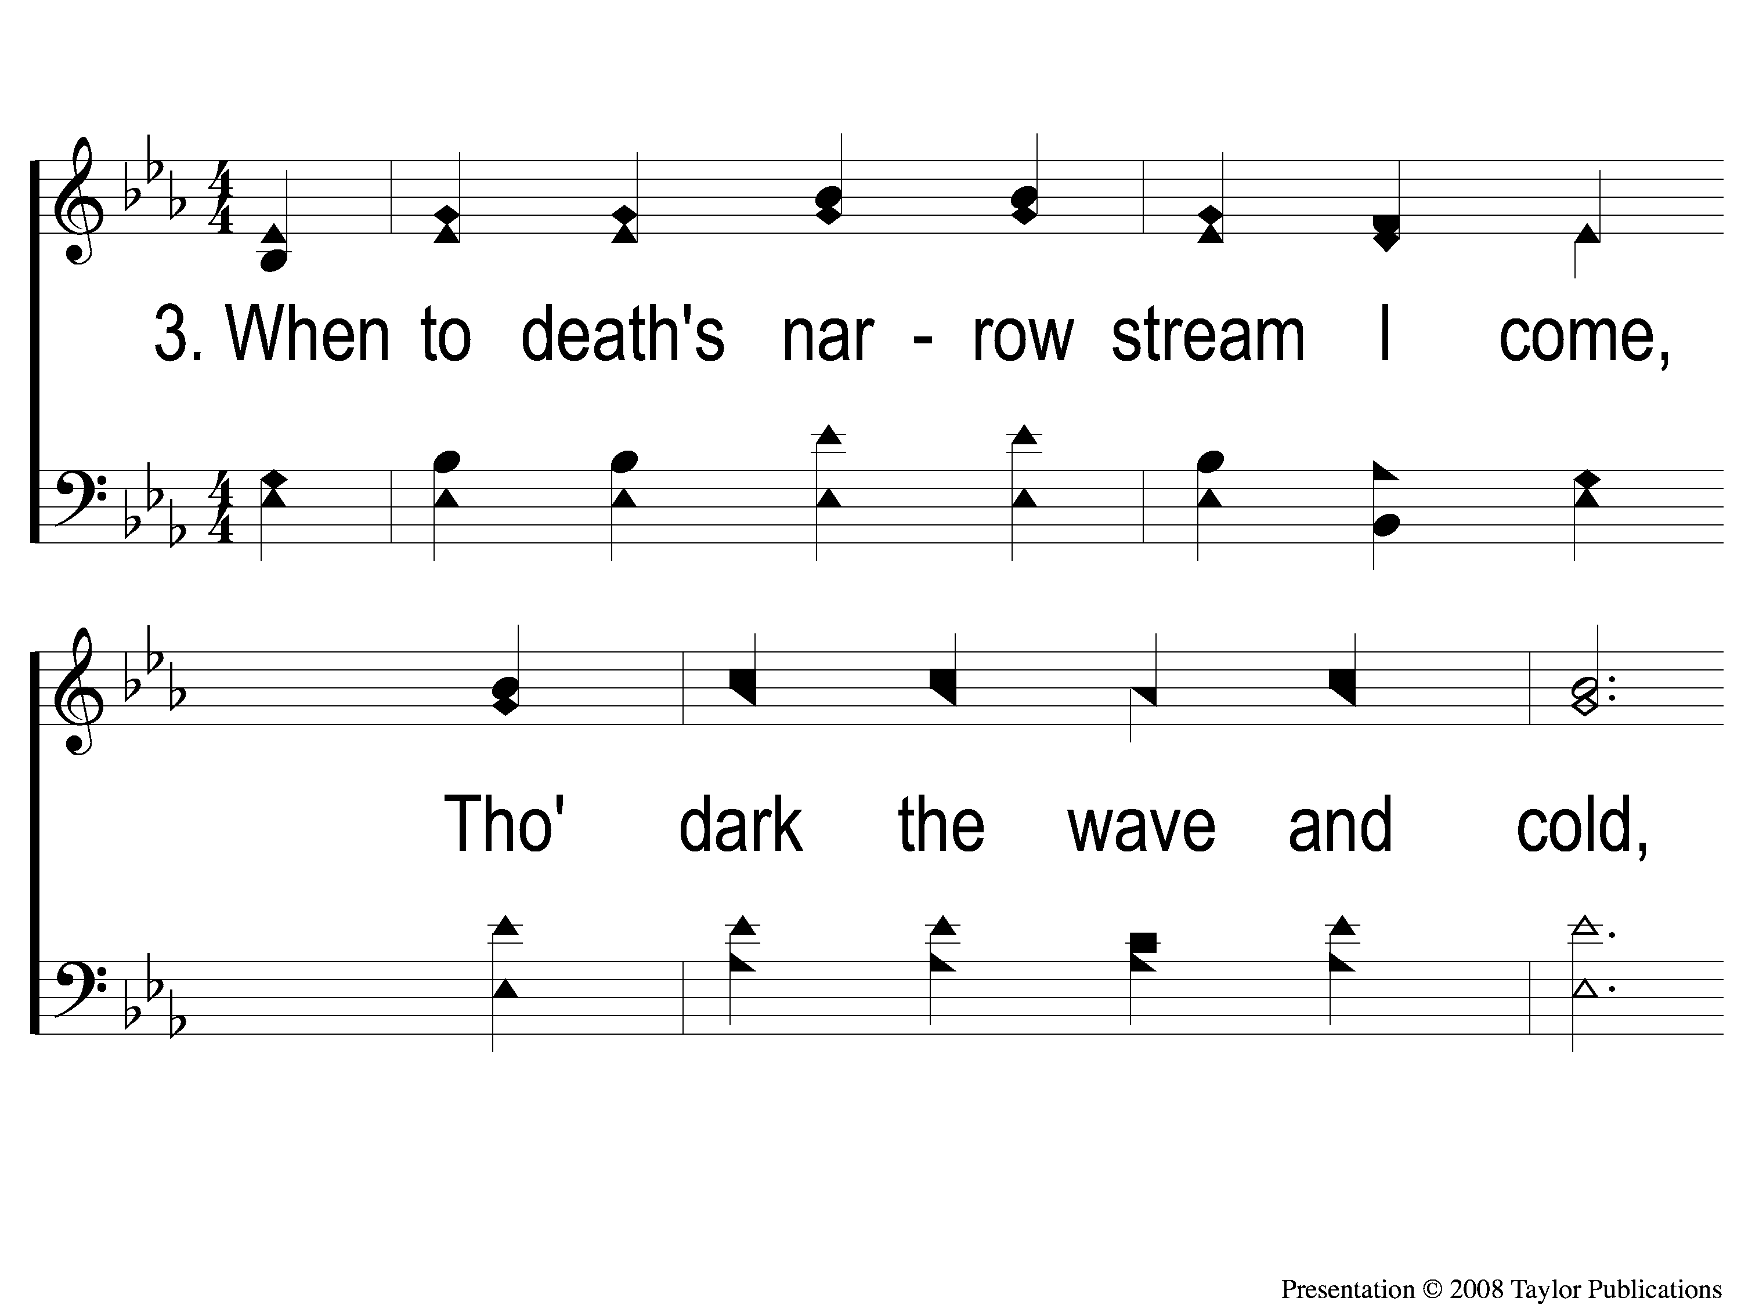
3-1 Follow On
Follow On
110

Slide 8
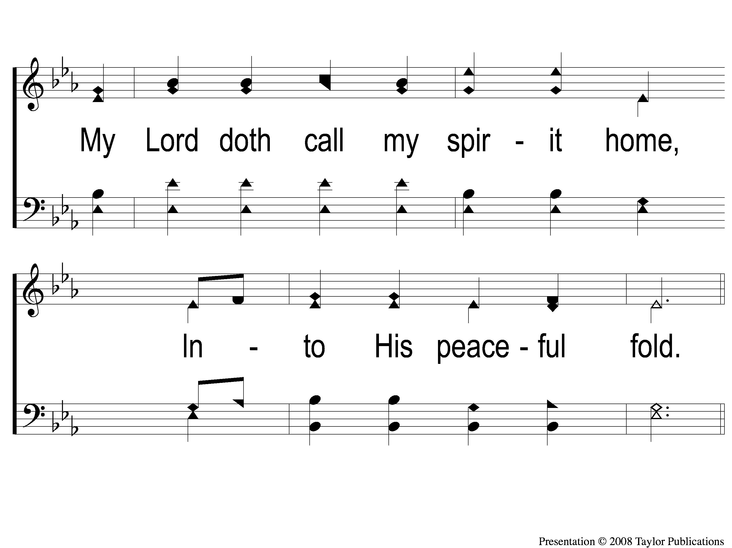
3-2 Follow On
Follow On
110

Slide 9
C Follow On
Follow On
110

Slide 10
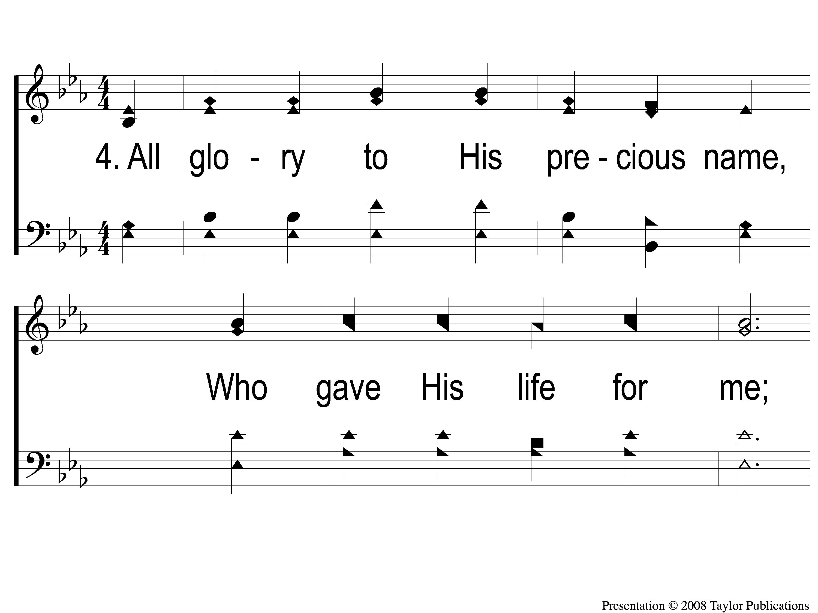
4-1 Follow On
Follow On
110

Slide 11
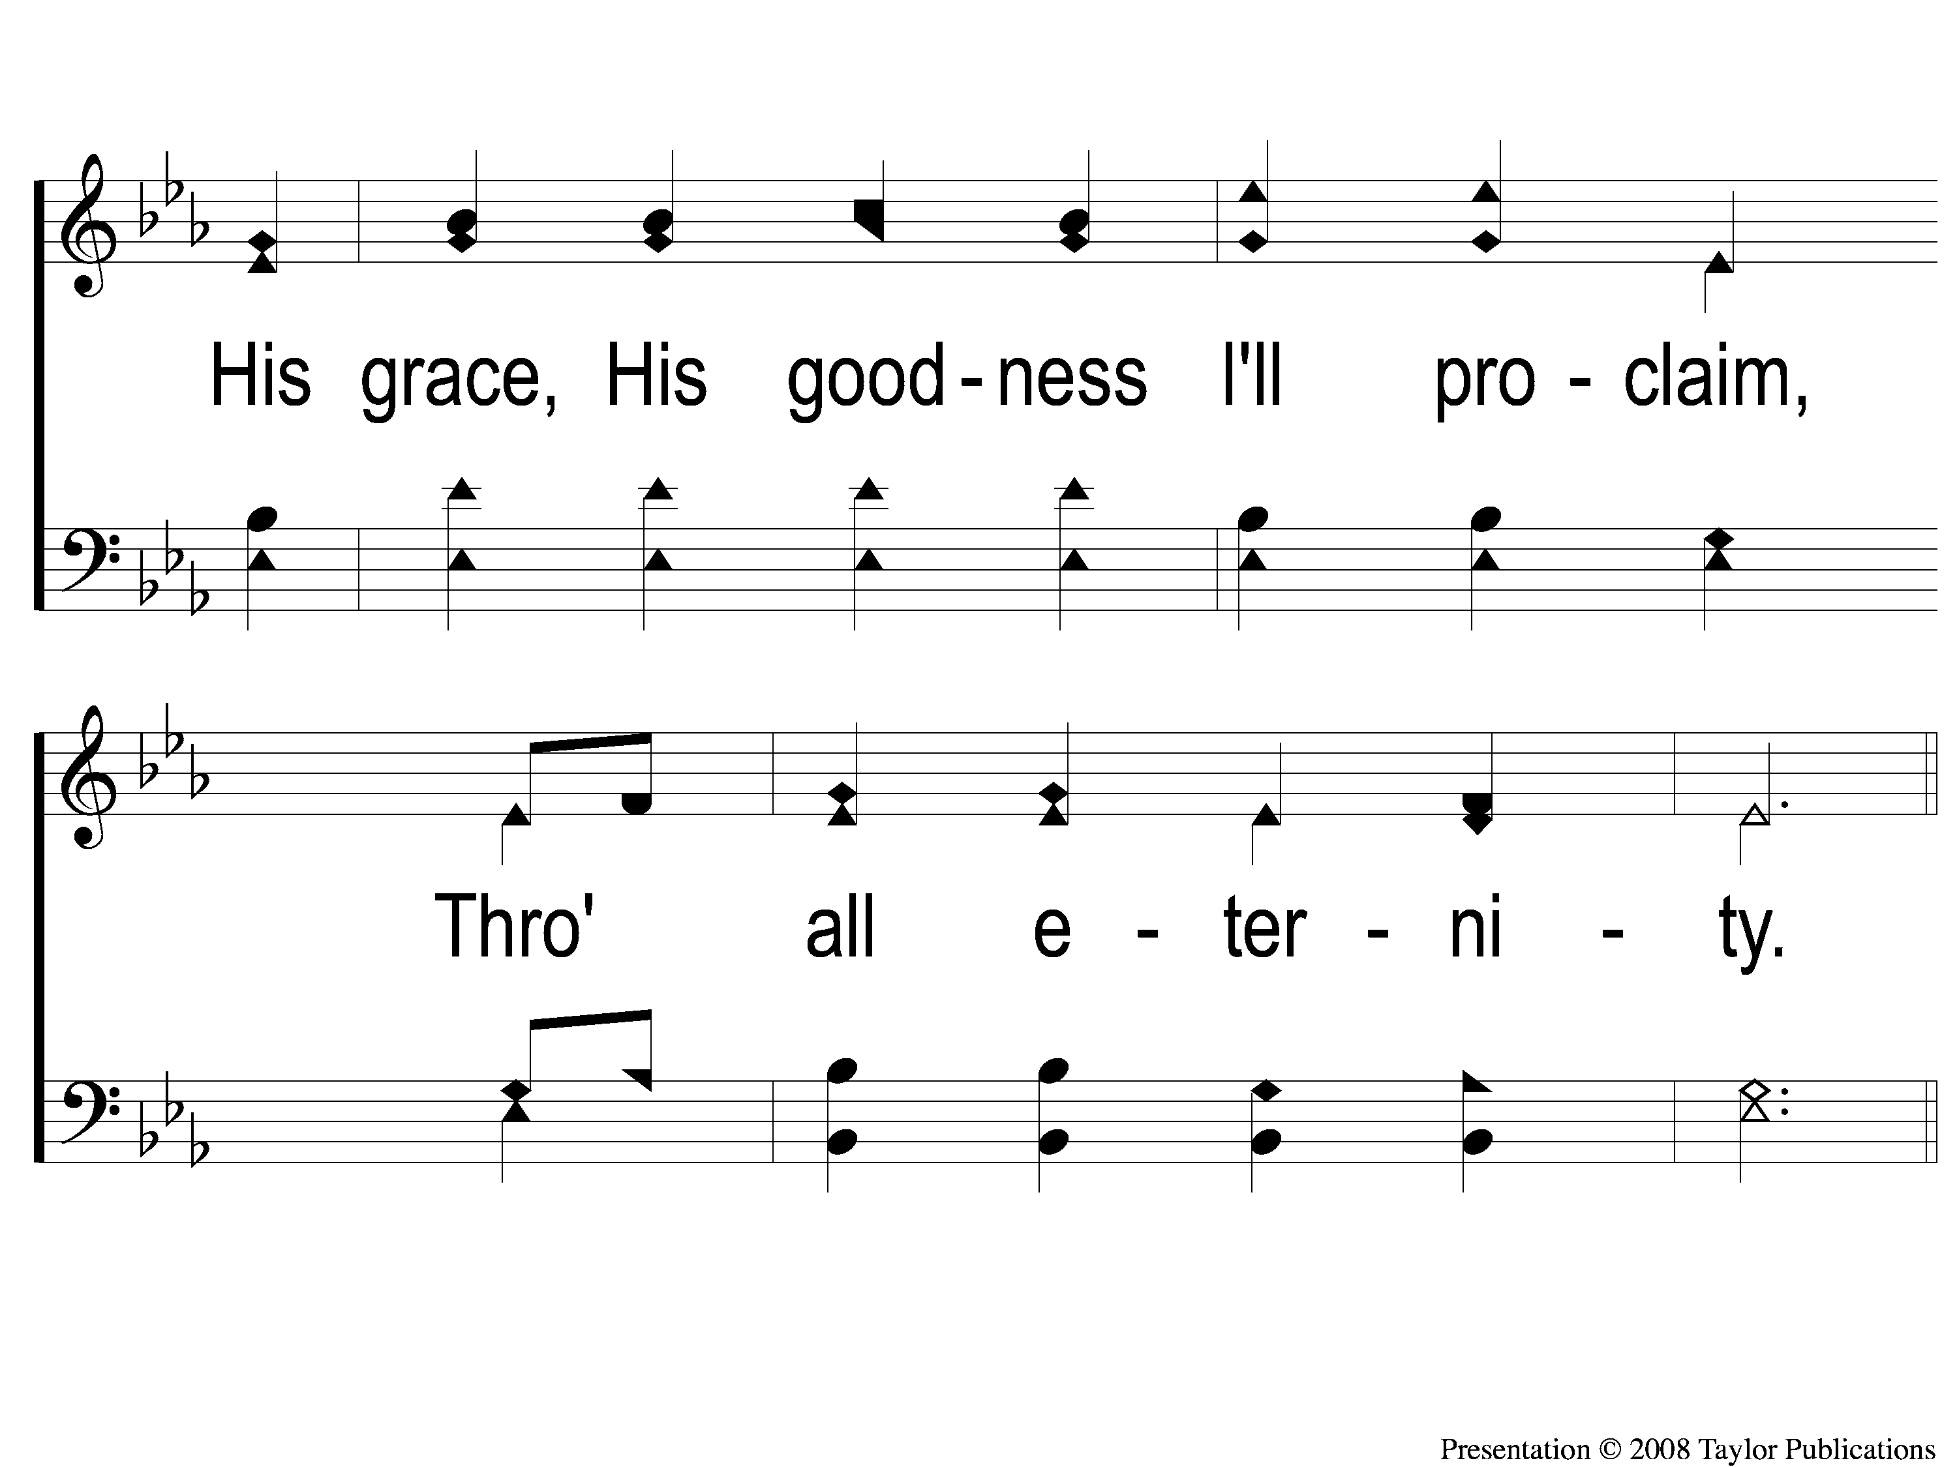
4-2 Follow On
Follow On
110

Slide 12
C Follow On
Follow On
110

